Slide 1
ND1
TRPL

Slide 2
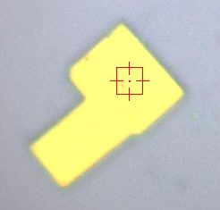
1
2
3
11
4
12
13
5
9
10
6
8
7
20µm

Slide 3
Pt1

Slide 4
pt1
T1 = 0.61148
T2 = 1.99191

Slide 5
pt2

Slide 6
pt2
T1 = 0.11578
T2 = 0.84638

Slide 7
pt3

Slide 8
pt3
T1 = 0.6782
T2 = 2.79091

Slide 9
pt4

Slide 10
pt4
T1 = 0.12977
T2 = 0.73099

Slide 11
pt5

Slide 12
pt5
T1 = 0.53678
T2 = 1.56469

Slide 13
pt6

Slide 14
pt6
T1 = 0.70719
T2 = 0.16771

Slide 15
pt7

Slide 16
pt7
T1 = 0.47334
T2 = 1.21842

Slide 17
pt8

Slide 18
pt8
T1 = 0.49967
T2 = 1.47951

Slide 19
pt9

Slide 20
pt9
T1 = 0.58014
T2 = 1.86353

Slide 21
pt10

Slide 22
pt10
T1 = 0.54619
T2 = 1.8534

Slide 23
pt11

Slide 24
pt11
T1 = 0.4903
T2 = 1.3348

Slide 25
pt12

Slide 26
pt12
T1 = 0.45522
T2 = 1.7696

Slide 27
pt13

Slide 28
pt13
T1 = 0.41433
T2 = 1.50698

